Slide 1

PRELIMINARY
Well Spacing Calculations for the Trinity Aquifer,
Kimble County Groundwater Conservation District
January 20, 2025
Alyson McDonald, Ph.D., P.G.
Senior Hydrologist
Collier Consulting

Slide 2
Outline
Edwards-Trinity Aquifer
Groundwater Availability Model (GAM)
Approach to well spacing
Hydraulic Properties
Water well data
Drawdown calculations
Well spacing recommendations

Slide 3
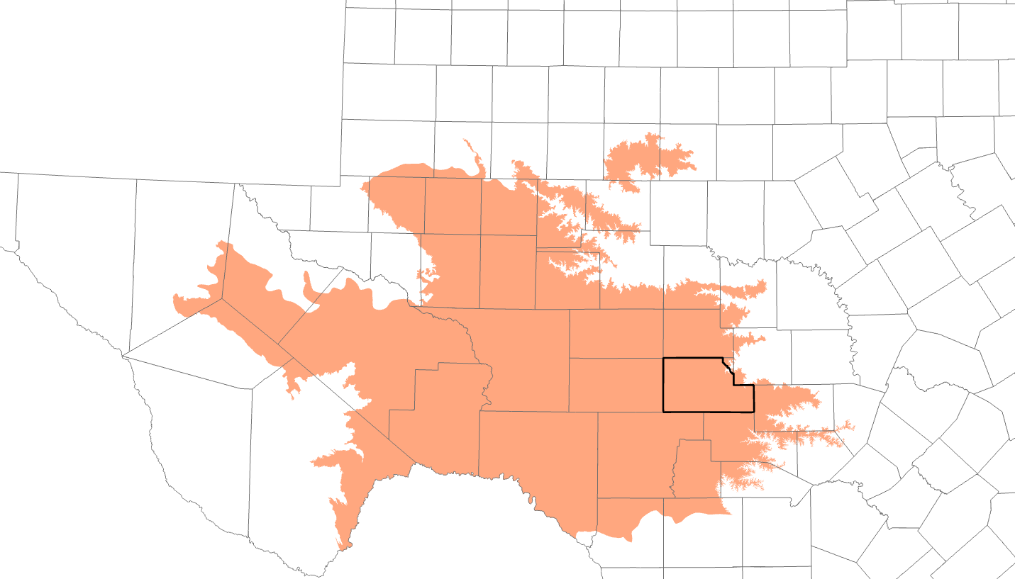
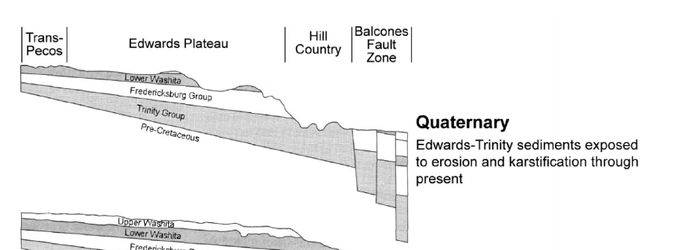
Edwards Trinity Plateau Aquifer
(modified from Barker and Ardis, 1996) from Conceptual model report

Slide 4

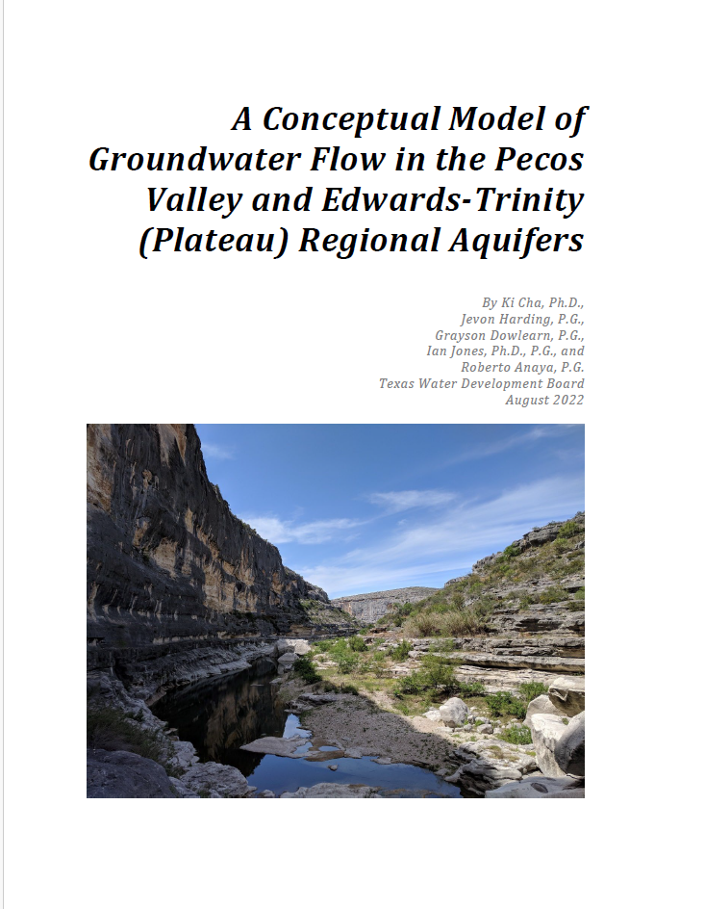

Slide 5
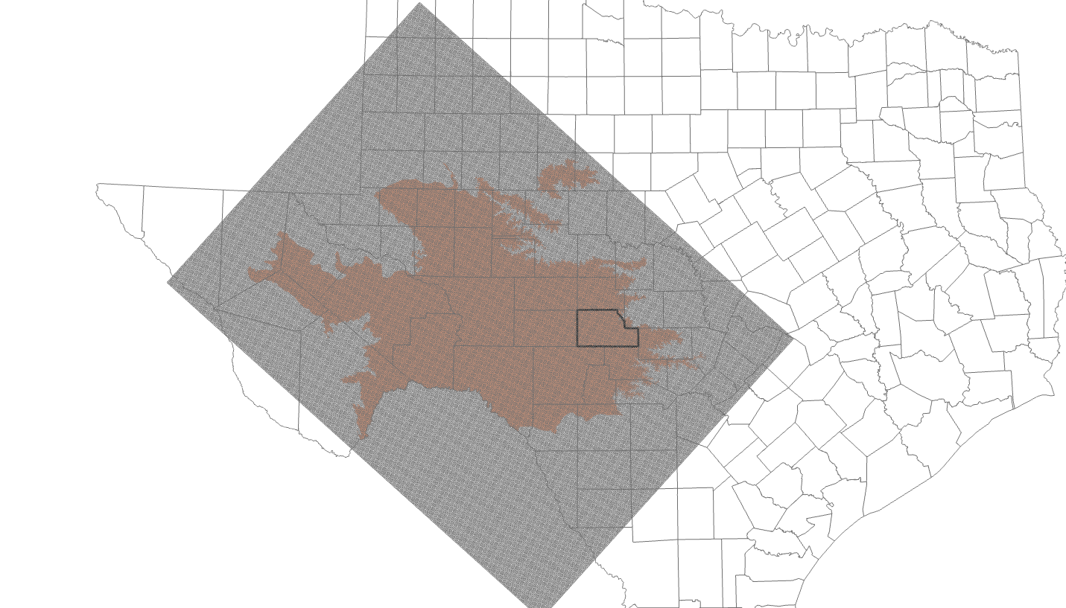
Edwards Trinity Plateau Groundwater Availability Model (EDDT GAM)
400 columns
300 rows
120,000 cells (1 mi x 1mi)
Layer 1: Edwards
Layer 2: Trinity
Notes:
300 cells by 400 cells
Rows columns
Layers - aquifers

Slide 6
Proposed Process
  Step 1: Extract hydraulic property data (K, B, Ss and Sy) for EDDT GAM Layers 1 (Edwards) and 2 (Trinity) and calculate Transmissivity & Storativity
  Step 2: Evaluate available well data (Texas Water Development Board) and select well capacities (gpm)
  Step 3: Calculate distance drawdown for well capacities for a duration of 50 years (DFC planning)
  Step 4: Recommend well spacing for selected well capacities

Slide 7
Actual Process
  Step 1: Extracted hydraulic property data (K, B, Ss and Sy) from EDDT GAM
    Calculated layer thickness and delineated zones for each aquifer
    Evaluated control points (field measurements) of hydraulic properties
    Consulted conceptual model report for hydraulic conductivity, specific yield, and specific storage values
    Assigned revised hydraulic conductivity, specific yield, and specific storage values to each zone
    Downloaded recent water level measurements for wells in Kimble County, calculated available drawdown
    Computed saturated thickness (bottom depth of the aquifer minus depth to water)
    Calculated transmissivity for each zone (saturated thickness x hydraulic conductivity)

Slide 8
Actual Process, cont’d.
  Step 2: Evaluate available well data (Texas Water Development Board) and select well capacities (gpm)
  Step 3: Calculate distance drawdown for well capacities for a duration of 50 years (DFC planning)
  Step 4: Recommend well spacing for selected well capacities

Slide 9
Aquifer Properties
  Thickness (B) – top to bottom (ft)
  Specific Storage, Specific Yield (Ss, Sy) – volume of water released per surface area when head is lowered (unitless)
  Hydraulic Conductivity (K) – rate that water moves through the aquifer under a hydraulic gradient (ft per day)
  Transmissivity (T) – Rate or volume that water moves through the thickness of the aquifer (ft² per day). It is the product of saturated thickness and hydraulic conductivity.

Slide 10
Edwards Aquifer

Slide 11
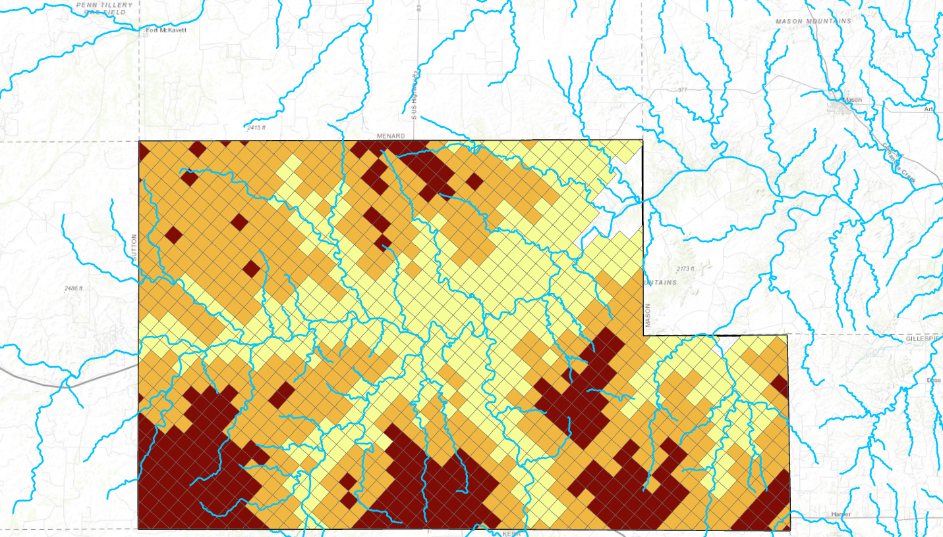
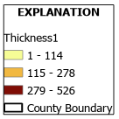
Edwards Thickness (ft) GAM Layer 1
ZONE 2
ZONE 1
ZONE 3

Slide 12
Storage (Sy) - Edwards

Slide 13
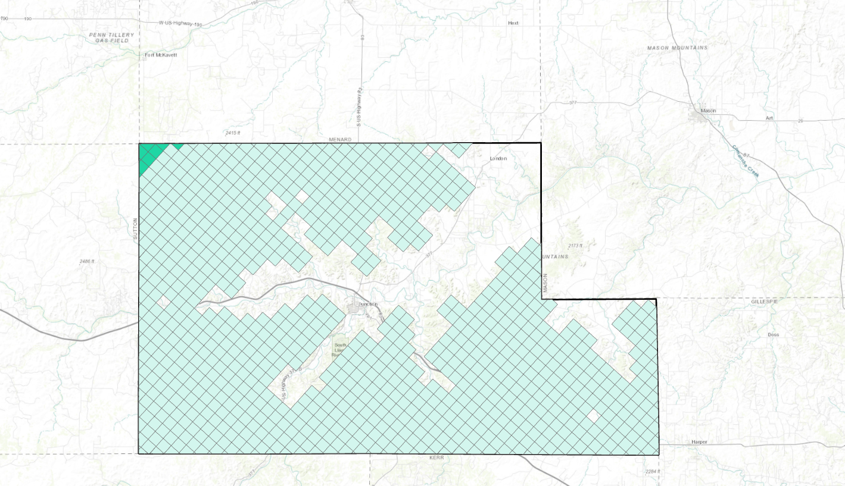
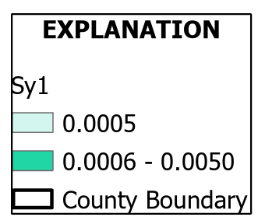
Edwards Aquifer Specific Yield GAM calibrated
Specific Yield = 0.009 from EDDT GAM Conceptual Model Report

Slide 14
Hydraulic Conductivity (Ksat) - Edwards

Slide 15
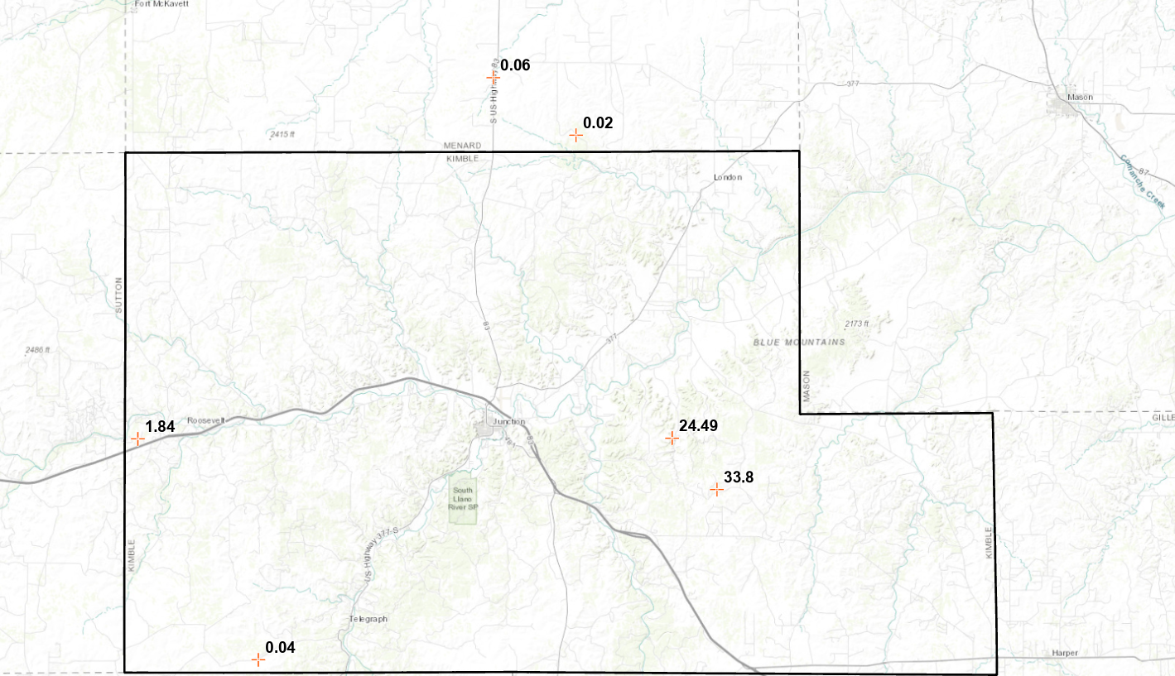
Edwards Aquifer Ksat (ft per day) GAM Control Points

Slide 16
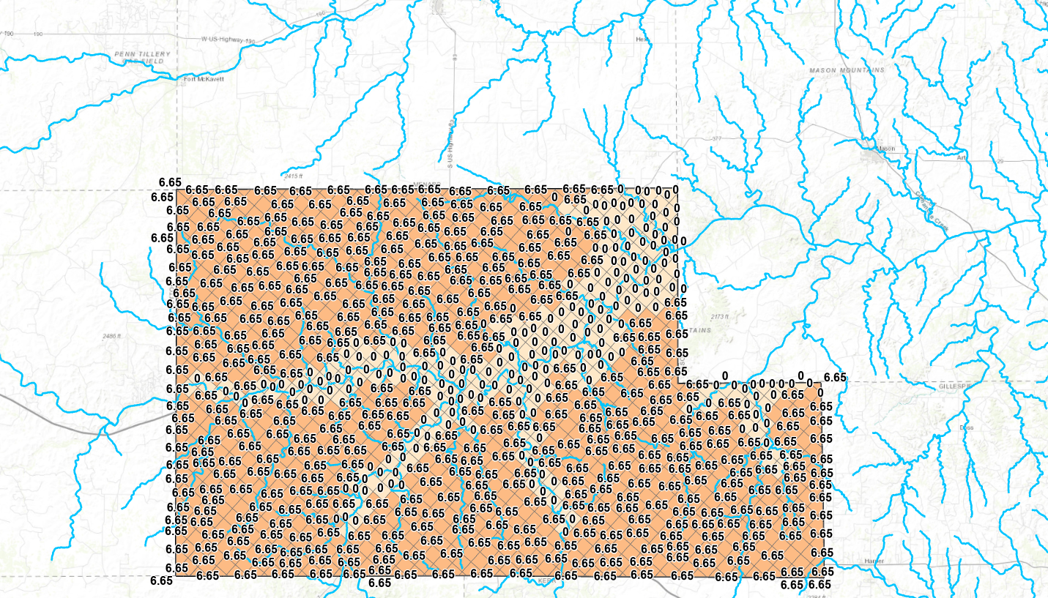
Ksat Edwards Aquifer GAM Calibrated

Slide 17
Saturated Thickness (B)- Edwards

Slide 18
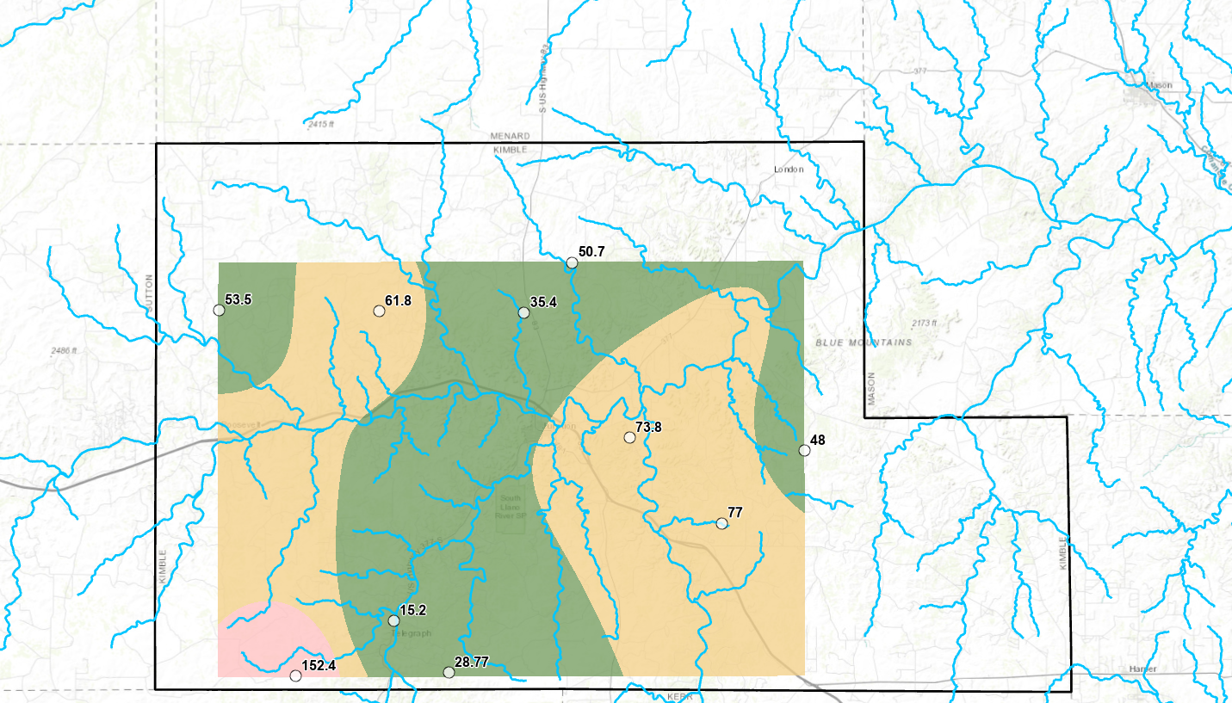
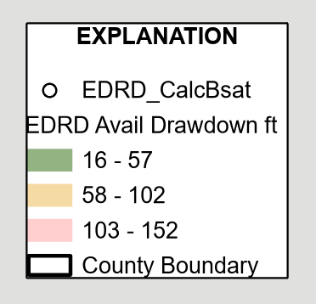
Edwards Aquifer Available Drawdown
Well Depth (ft) minus Depth to Water (ft)

Slide 19
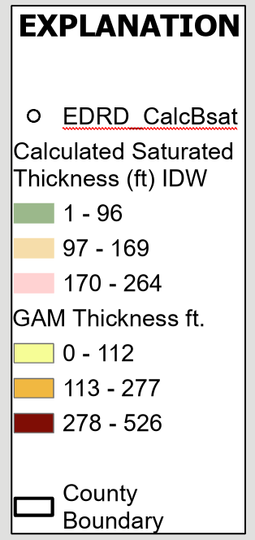
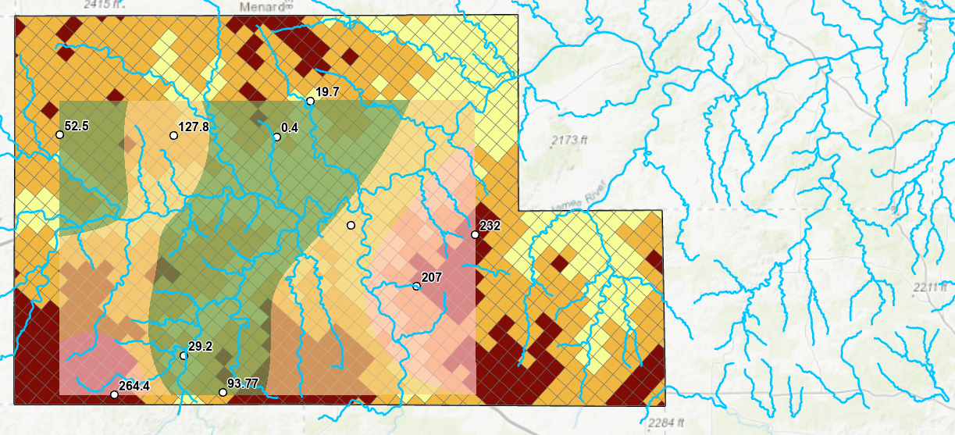
Edwards Aquifer Saturated Thickness Overlain on GAM Thickness
Saturated Thickness
ZONE 1: 50 ft
ZONE 2: 130 ft
ZONE 3: 220 ft

Slide 20
Transmissivity (T) – Edwards saturated thickness x hydraulic conductivity
Calculated Transmissivity Edwards Layer 1
Zone | K_{sat} (ft/day) | Saturated Thickness (ft) | Transmissivty (ft² /day)
1 | 6.65 | 50 | 332.5
2 | 6.65 | 130 | 864.5
3 | 6.65 | 220 | 1463

Slide 21
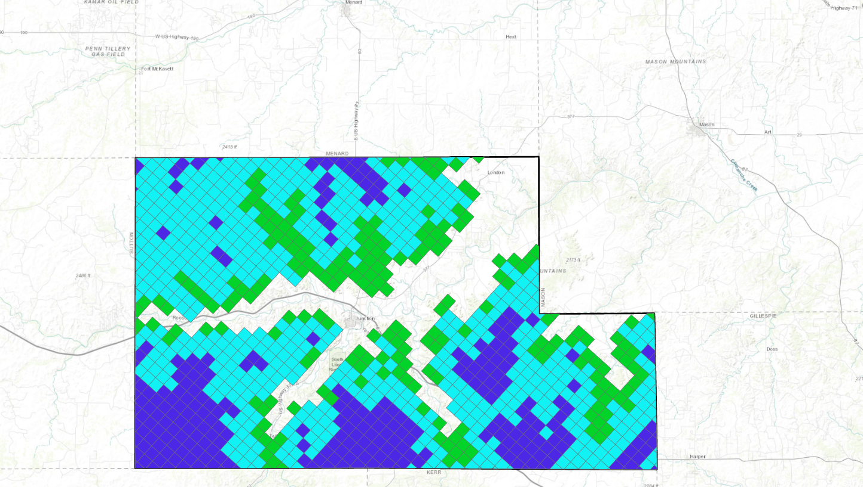
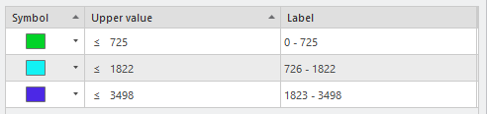
Edwards Transmissivity (ft² per day) GAM Layer 1 and Calculated
ZONE 2
Calculated Transmissivity Edwards Layer 1
Zone | K_{sat} (ft/day) | Saturated Thickness (ft) | Transmissivty (ft² /day)
1 | 6.65 | 50 | 332.5
2 | 6.65 | 130 | 864.5
3 | 6.65 | 220 | 1463
ZONE 1
ZONE 3

Slide 22
Well Yields – Kimble County

Slide 23
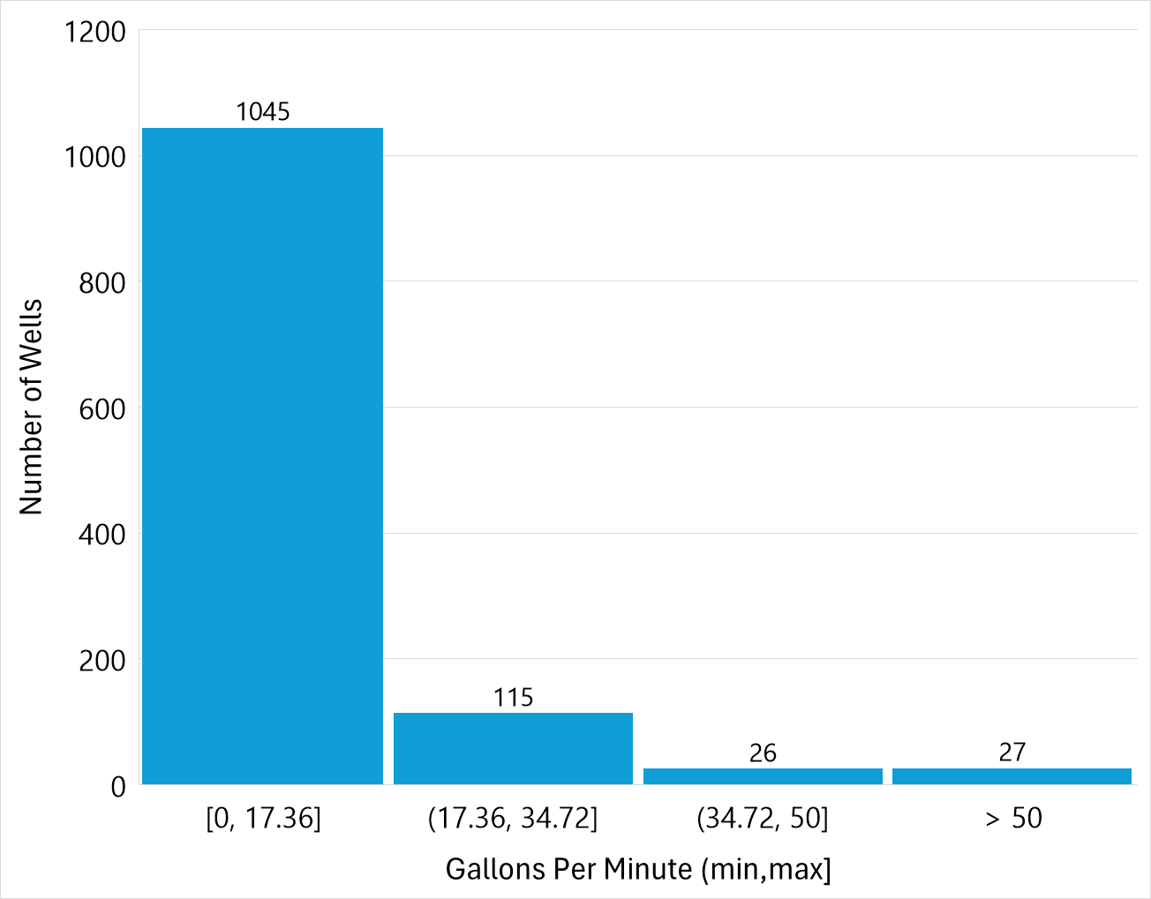
Driller Reported Well Yields Edwards & Trinity

Slide 24
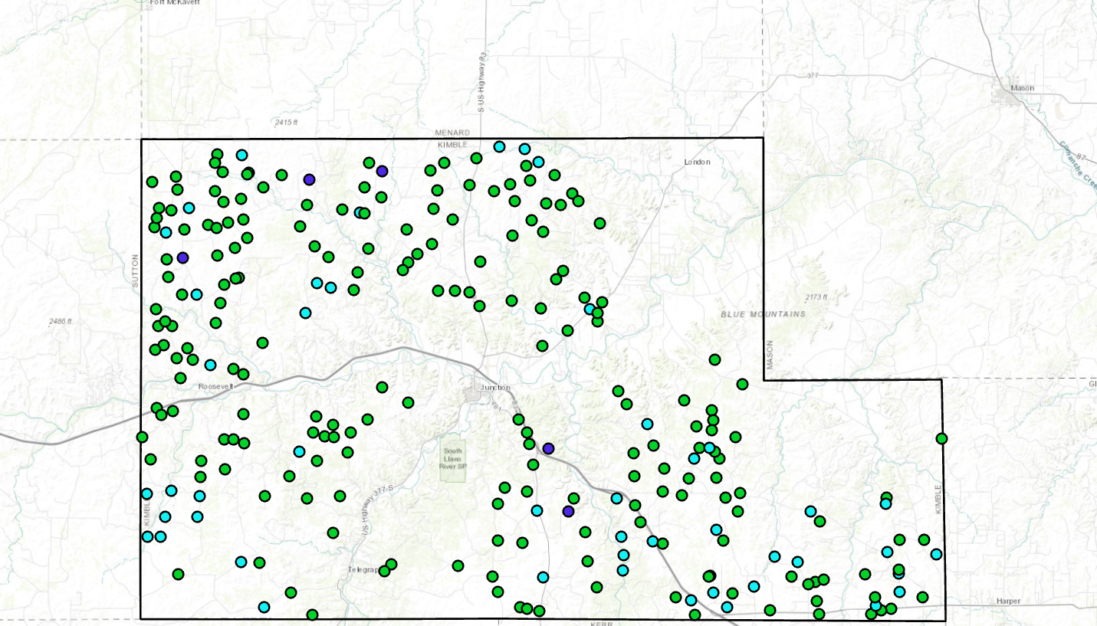
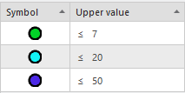
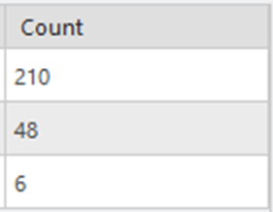
TWDB Reported Well Yields Edwards

Slide 25
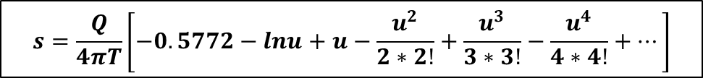

Theis Distance Drawdown
Edwards Aquifer

Slide 29
Zone 1 |  |  |  |  |  |  | Zone 2 |  |  |  |  |  |  | Zone 3
gpm | 17.36 | 30 | 50 | 100 | 300 |  | gpm | 17.36 | 30 | 50 | 100 | 300 |  | gpm | 17.36 | 30 | 50 | 100 | 300
r Dist. (ft) | S | S | S | S | S |  | r Dist. (ft) | S | S | S | S | S |  | r Dist. (ft) | S | S | S | S | S
1 | 16.9 | 29.2 | 48.7 | 97.4 | 292.2 |  | 1 | 6.8 | 11.7 | 19.6 | 39.1 | 117.4 |  | 1 | 4.1 | 7.1 | 11.8 | 23.7 | 71.1
50 | 10.6 | 18.4 | 30.7 | 61.3 | 184.0 |  | 50 | 4.4 | 7.6 | 12.6 | 25.3 | 75.9 |  | 50 | 2.7 | 4.6 | 7.7 | 15.5 | 46.5
100 | 9.5 | 16.5 | 27.5 | 55.0 | 164.9 |  | 100 | 4.0 | 6.8 | 11.4 | 22.8 | 68.5 |  | 100 | 2.4 | 4.2 | 7.0 | 14.0 | 42.1
200 | 8.4 | 14.6 | 24.3 | 48.6 | 145.7 |  | 200 | 3.5 | 6.1 | 10.2 | 20.4 | 61.1 |  | 200 | 2.2 | 3.8 | 6.3 | 12.6 | 37.8
300 | 7.8 | 13.4 | 22.4 | 44.8 | 134.5 |  | 300 | 3.3 | 5.7 | 9.5 | 18.9 | 56.8 |  | 300 | 2.0 | 3.5 | 5.9 | 11.7 | 35.2
400 | 7.3 | 12.7 | 21.1 | 42.2 | 126.5 |  | 400 | 3.1 | 5.4 | 9.0 | 17.9 | 53.7 |  | 400 | 1.9 | 3.3 | 5.6 | 11.1 | 33.4
500 | 7.0 | 12.0 | 20.1 | 40.1 | 120.4 |  | 500 | 3.0 | 5.1 | 8.6 | 17.1 | 51.4 |  | 500 | 1.9 | 3.2 | 5.3 | 10.7 | 32.0
1000 | 5.9 | 10.1 | 16.9 | 33.7 | 101.2 |  | 1000 | 2.5 | 4.4 | 7.3 | 14.7 | 44.0 |  | 1000 | 1.6 | 2.8 | 4.6 | 9.2 | 27.7
1200 | 5.6 | 9.6 | 16.0 | 32.1 | 96.2 |  | 1200 | 2.4 | 4.2 | 7.0 | 14.0 | 42.1 |  | 1200 | 1.5 | 2.7 | 4.4 | 8.8 | 26.5
1500 | 5.2 | 9.0 | 15.0 | 30.0 | 90.0 |  | 1500 | 2.3 | 4.0 | 6.6 | 13.2 | 39.7 |  | 1500 | 1.5 | 2.5 | 4.2 | 8.4 | 25.1
2000 | 4.7 | 8.2 | 13.7 | 27.4 | 82.1 |  | 2000 | 2.1 | 3.7 | 6.1 | 12.2 | 36.6 |  | 2000 | 1.3 | 2.3 | 3.9 | 7.8 | 23.3
2500 | 4.4 | 7.6 | 12.7 | 25.3 | 75.9 |  | 2500 | 2.0 | 3.4 | 5.7 | 11.4 | 34.3 |  | 2500 | 1.3 | 2.2 | 3.7 | 7.3 | 21.9
3000 | 4.1 | 7.1 | 11.8 | 23.6 | 70.9 |  | 3000 | 1.9 | 3.2 | 5.4 | 10.8 | 32.3 |  | 3000 | 1.2 | 2.1 | 3.5 | 6.9 | 20.8
3500 | 3.9 | 6.7 | 11.1 | 22.2 | 66.6 |  | 3500 | 1.8 | 3.1 | 5.1 | 10.2 | 30.7 |  | 3500 | 1.1 | 2.0 | 3.3 | 6.6 | 19.8
4000 | 3.6 | 6.3 | 10.5 | 21.0 | 63.0 |  | 4000 | 1.7 | 2.9 | 4.9 | 9.8 | 29.3 |  | 4000 | 1.1 | 1.9 | 3.2 | 6.3 | 19.0
4500 | 3.5 | 6.0 | 10.0 | 19.9 | 59.7 |  | 4500 | 1.6 | 2.8 | 4.7 | 9.3 | 28.0 |  | 4500 | 1.1 | 1.8 | 3.0 | 6.1 | 18.2
5280 | 3.2 | 5.5 | 9.2 | 18.5 | 55.4 |  | 5280 | 1.5 | 2.6 | 4.4 | 8.8 | 26.3 |  | 5280 | 1.0 | 1.7 | 2.9 | 5.7 | 17.2

Slide 30
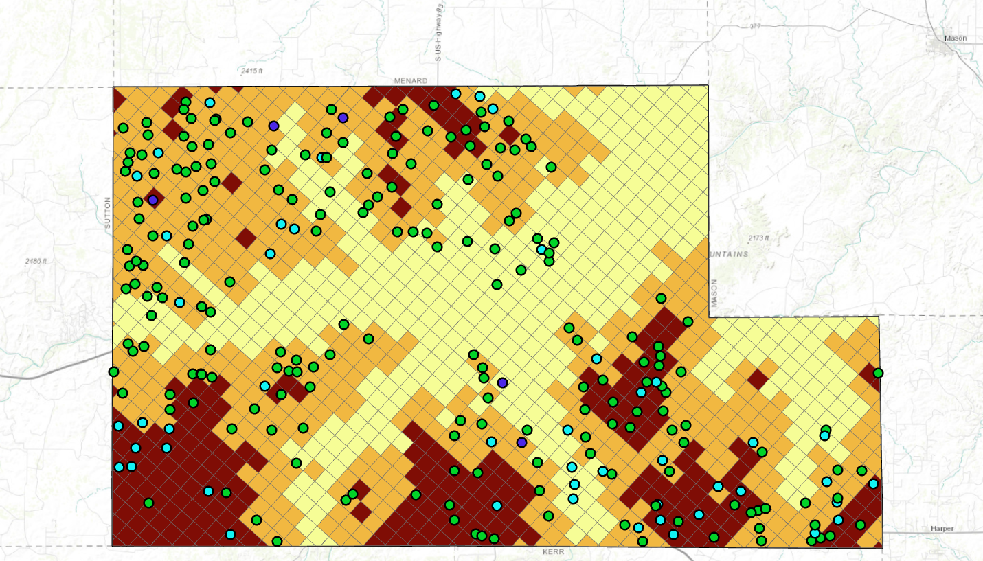
TWDB Reported Well Yields Edwards Zones

Slide 31
Pumping Capacity of Well As Equipped (gpm) | Minimum Distance from Existing Water Well (ft)
ZONE 1
Up to 17.36 gpm | 150
> 17.36 to 30 gpm | 150
> 30 gpm to 50 gpm | 150
> 50 gpm to 100 gpm | 1200
> 100 gpm to 300 gpm | na
> 300 gpm | na
ZONE 2
Up to 17.36 gpm | 150
> 17.36 to 30 gpm | 150
> 30 gpm to 50 gpm | 150
> 50 gpm to 100 gpm | 500
> 100 gpm to 300 gpm | na
> 300 gpm | na
ZONE 3
Up to 17.36 gpm | 150
> 17.36 to 30 gpm | 150
> 30 gpm to 50 gpm | 150
> 50 gpm to 100 gpm | 150
> 100 gpm to 300 gpm | 150
> 300 gpm | 150

Slide 32
Trinity Aquifer

Slide 33
Outline
Trinity Aquifer
Groundwater Availability Model (GAM)
Approach to well spacing
Hydraulic properties
Water well data
Drawdown calculations
Well spacing recommendations

Slide 34
Edwards Trinity Plateau Aquifer

Slide 36
Edwards Trinity Plateau Groundwater Availability Model (EDDT GAM)
400 columns
300 rows
120,000 cells (1 mi x 1mi)
Layer 1: Edwards
Layer 2: Trinity
Notes:
300 cells by 400 cells
Rows columns
Layers - aquifers

Slide 37
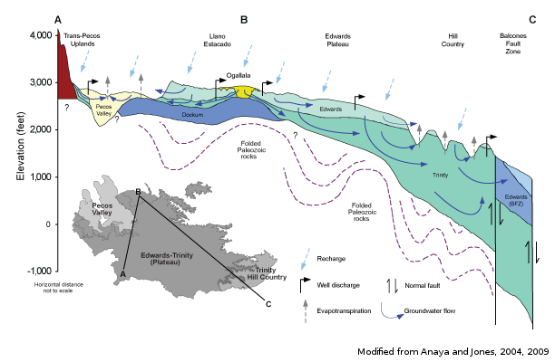
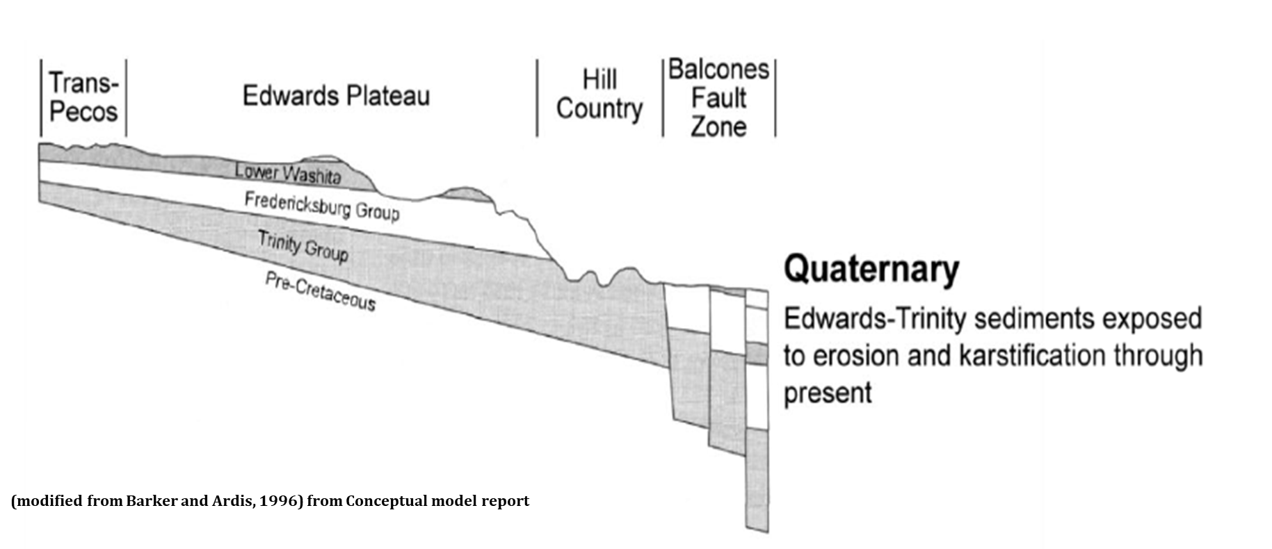

Slide 38
Process
  Step 1: Extracted hydraulic property data (K, B, Ss and Sy) from EDDT GAM
    Calculated layer thickness and delineated zones for each aquifer
    Evaluated control points (field measurements) of hydraulic properties
    Consulted conceptual model report for hydraulic conductivity, specific yield, and specific storage values
    Assigned revised hydraulic conductivity, specific yield, and specific storage values to each zone
    Downloaded recent water level measurements for wells in Kimble County, calculated available drawdown
    Computed saturated thickness (bottom depth of the aquifer minus depth to water)
    Calculated transmissivity for each zone (saturated thickness x hydraulic conductivity)

Slide 39
Process, cont’d.
  Step 2: Evaluate available well data (Texas Water Development Board) and select well capacities (gpm)
  Step 3: Calculate distance drawdown for well capacities for a duration of 50 years (DFC planning)
  Step 4: Recommend well spacing for selected well capacities

Slide 40
Step 1. Aquifer Properties
  Thickness (B) – top to bottom (ft)
  Specific Storage, Specific Yield (Ss, Sy) – volume of water released per surface area of aquifer when head is lowered (unitless)
  Hydraulic Conductivity (K) – rate that water moves through the aquifer under a hydraulic gradient (ft per day)
  Transmissivity (T) – Rate or volume that water moves through the thickness of the aquifer (ft² per day). It is the product of saturated thickness and hydraulic conductivity.

Slide 41
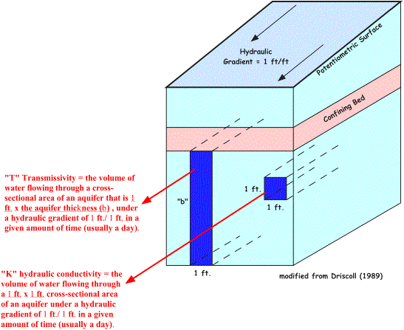

Slide 42
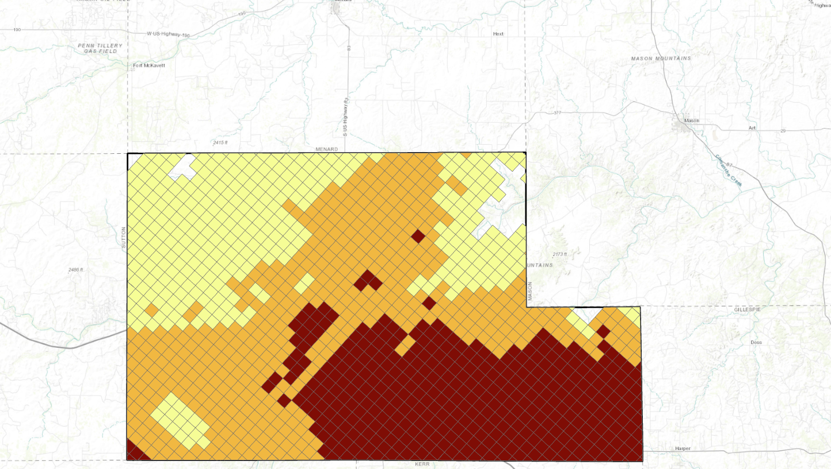
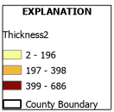
Trinity Thickness (ft) GAM Layer 2
ZONE 1
ZONE 2
ZONE 3

Slide 43
Storage (S) - Trinity

Slide 44
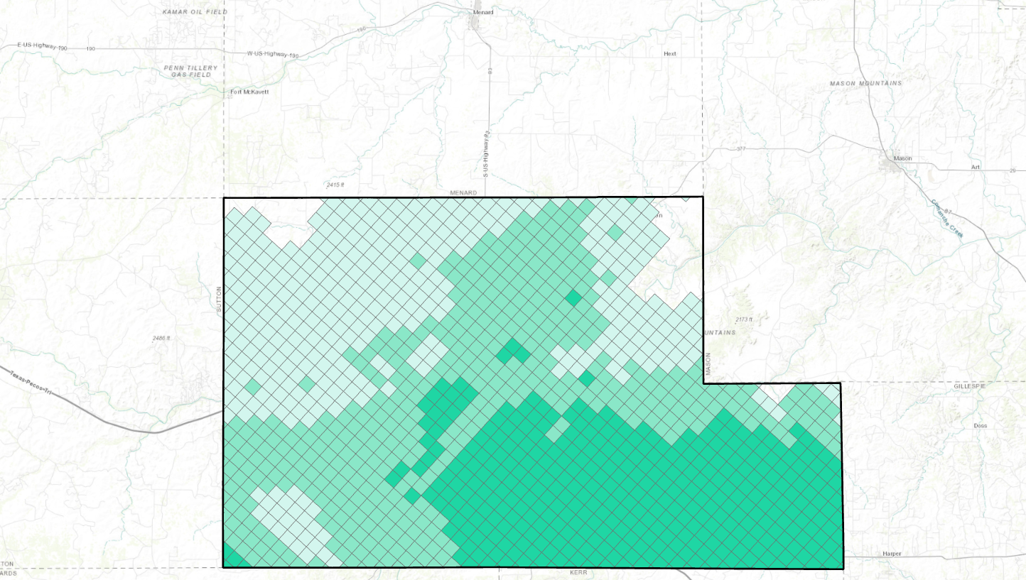
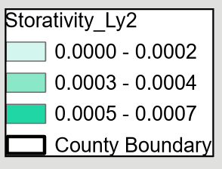
Trinity Aquifer Calibrated Storativity GAM
ZONE 1
ZONE 2
Storativity = 0.0003
ZONE 3

Slide 45
Hydraulic Conductivity (Ksat) - Trinity

Slide 46
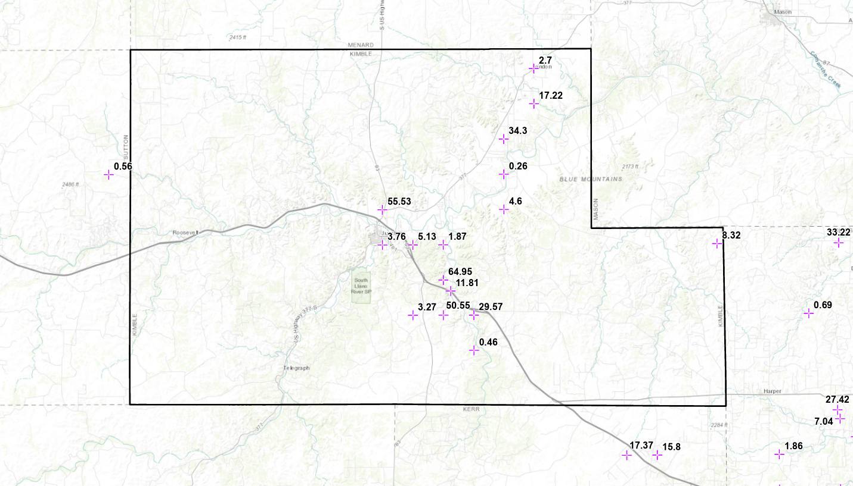
Trinity Aquifer Ksat (ft/day) GAM Control Points

Slide 47
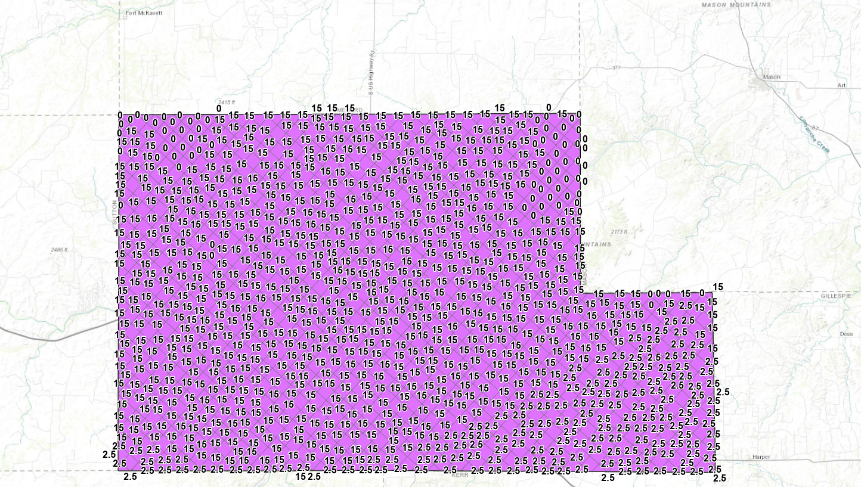
Ksat Trinity Aquifer Calibrated GAM
Notes:
In the North Plateau region of the Trinity hydrostratigraphic unit, the median hydraulic
conductivity derived from all well data is 7.0 feet per day.
5 ft per day for ZONE 3, Ksat will likely decrease further downdip.
17.37 and 16.8 from control points

Slide 48
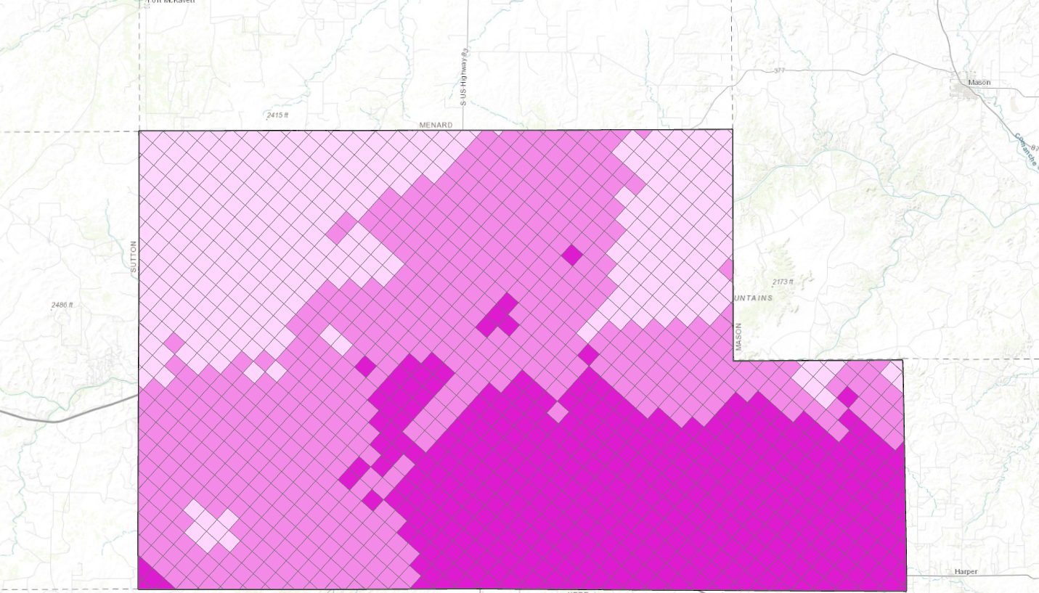
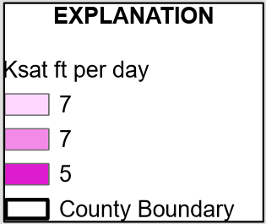
Ksat Trinity Aquifer (2022 conceptual model report)
ZONE 1
ZONE 2
ZONE 3

Slide 49
Saturated Thickness (B) – Trinity
Bottom of Aquifer (ft) – Depth to Water (ft)

Slide 50
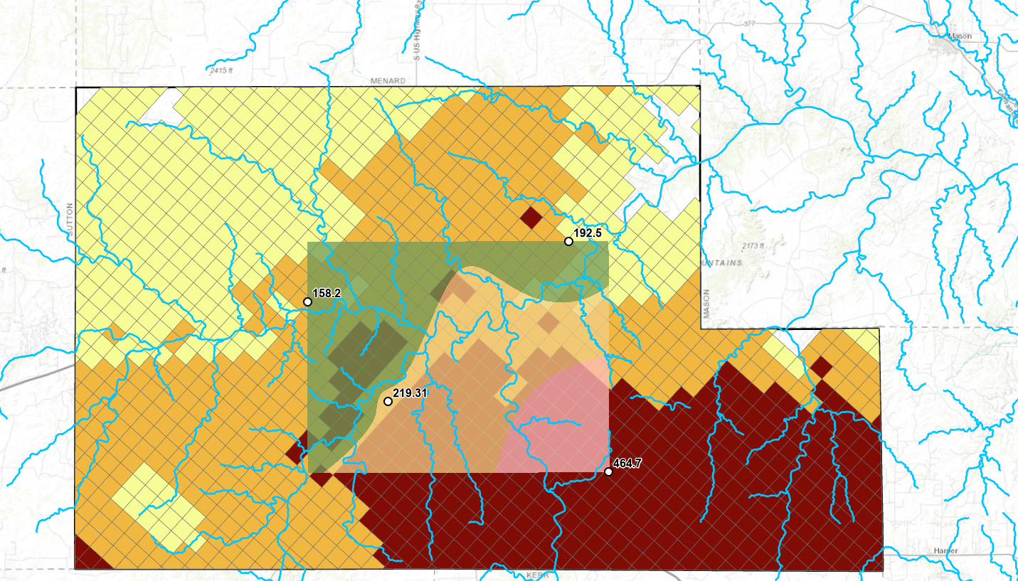
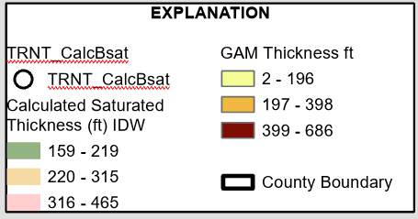
Trinity Aquifer Calculated Saturated Thickness Overlain on GAM Thickness
ZONE 1
Saturated Thickness
ZONE 1: 180 ft
ZONE 2: 275 ft
ZONE 3: 464 ft
ZONE 2
ZONE 3
Notes:
Bsat increases as move downdip; assume confined downdip portions of the aquifer are saturated.

Slide 51
Transmissivity (T) – Trinity saturated thickness x hydraulic conductivity
Calculated Transmissivity Trinity Layer 2
Zone | K_{sat} (ft/day) | Saturated Thickness (ft) | Transmissivty (ft² /day)
1 | 7 | 180 | 1260
2 | 7 | 275 | 1925
3 | 5 | 464 | 2320

Slide 52
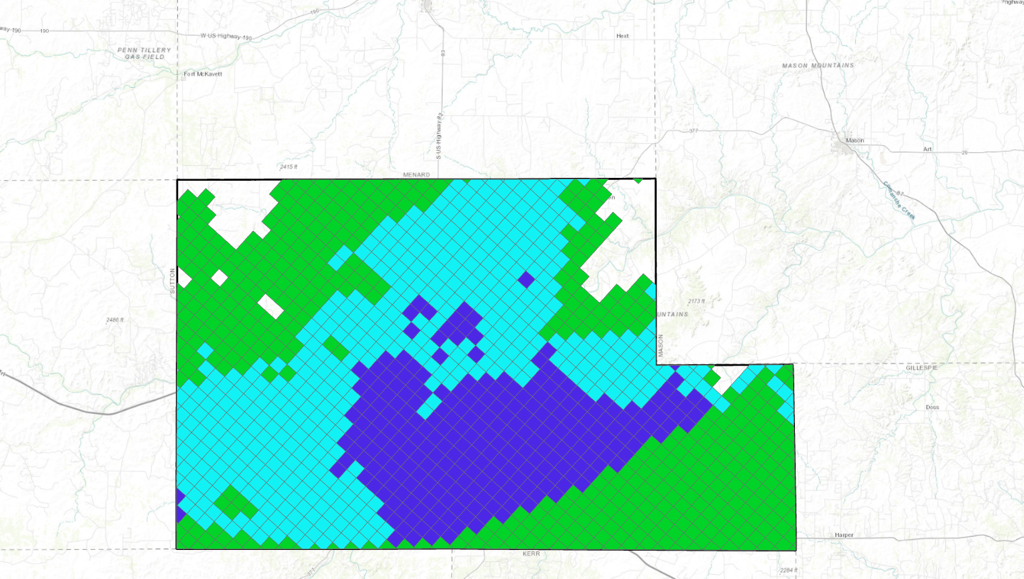
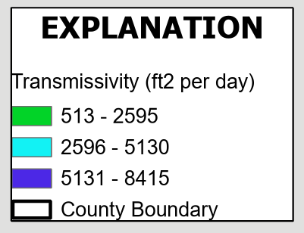
Trinity Transmissivity (ft² per day) GAM Layer 2
ZONE 2
ZONE 1
ZONE 3

Slide 53
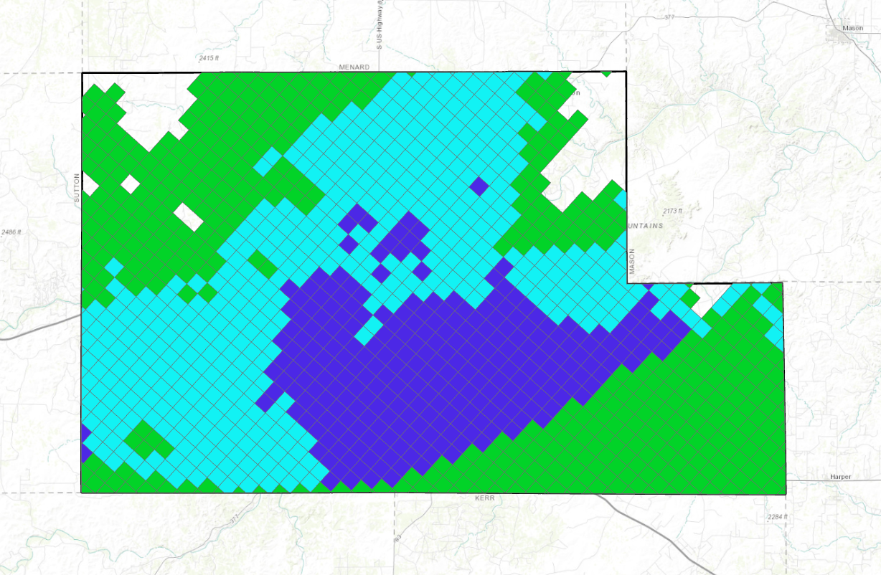
Calculated Trinity Transmissivity (ft² per day)
ZONE 2
Calculated Transmissivity Trinity Layer 2
Zone | K_{sat} (ft/day) | Saturated Thickness (ft) | Transmissivty (ft² /day)
1 | 7 | 180 | 1260
2 | 7 | 275 | 1925
3 | 5 | 464 | 2320
ZONE 1
ZONE 3

Slide 54
Driller Reported Well Yields Edwards & Trinity

Slide 55
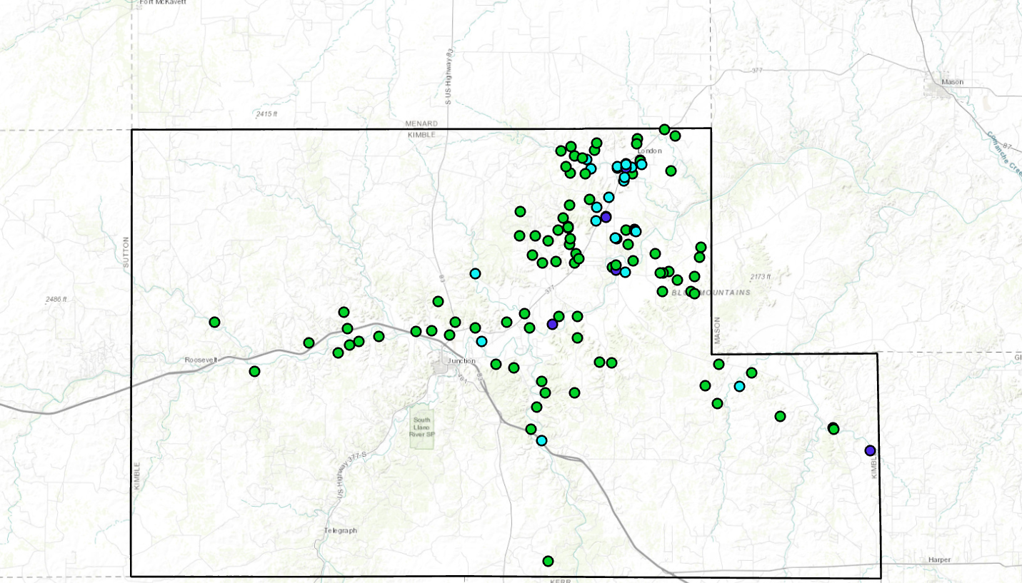
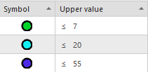
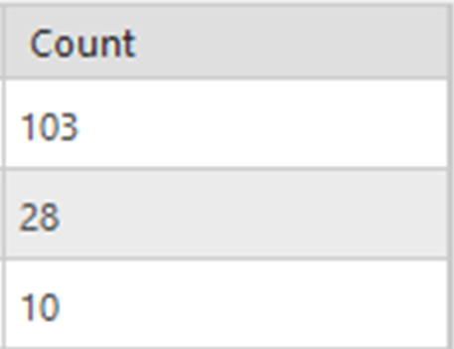
TWDB Reported Well Yields Trinity

Slide 56
Theis Distance Drawdown
Trinity Aquifer

Slide 60
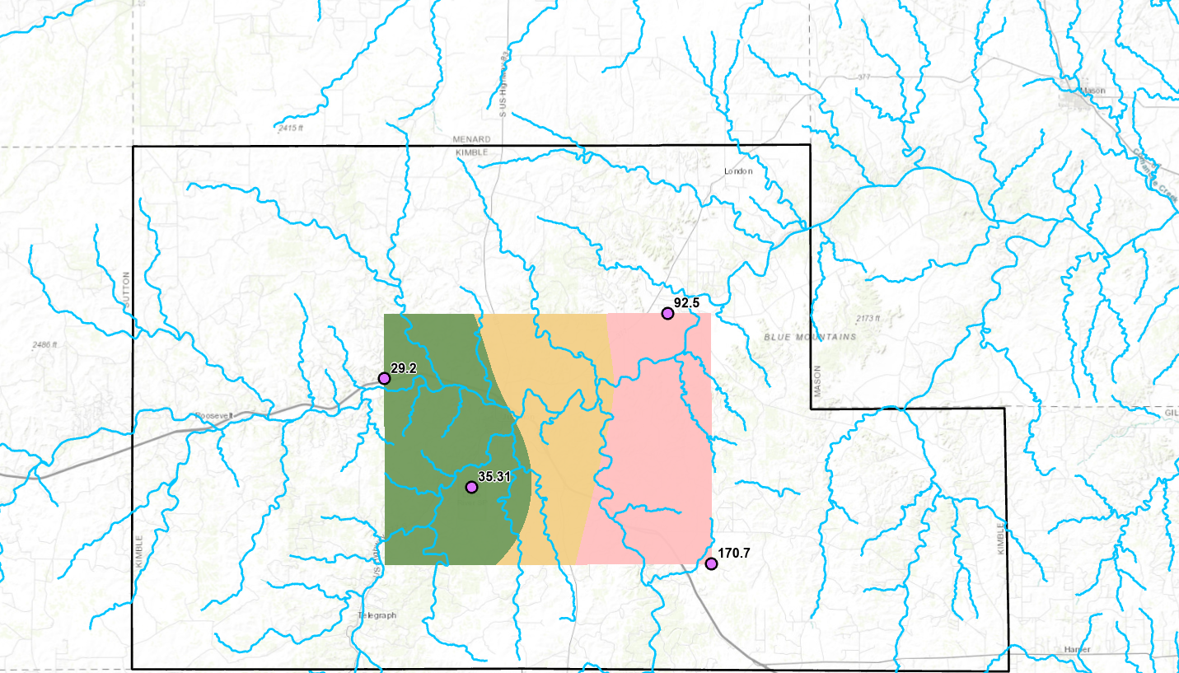
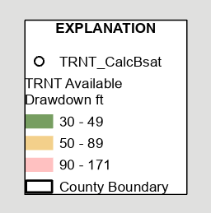
Trinity Aquifer Available Drawdown
Well Depth (ft) minus Depth to Water (ft)

Slide 61
Zone 1 |  |  |  |  |  |  | Zone 2 |  |  |  |  |  |  | Zone 3
gpm | 17.36 | 30 | 50 | 100 | 300 |  | gpm | 17.36 | 30 | 50 | 100 | 300 |  | gpm | 17.36 | 30 | 50 | 100 | 300
r Dist. (ft) | S | S | S | S | S |  | r Dist. (ft) | S | S | S | S | S |  | r Dist. (ft) | S | S | S | S | S
1 | 5.5 | 9.4 | 15.7 | 31.5 | 94.4 |  | 1 | 3.6 | 6.3 | 10.5 | 20.9 | 62.8 |  | 1 | 5.9 | 10.2 | 17.0 | 34.1 | 102.2
50 | 3.8 | 6.6 | 11.0 | 21.9 | 65.8 |  | 50 | 2.6 | 4.4 | 7.3 | 14.7 | 44.1 |  | 50 | 4.1 | 7.1 | 11.9 | 23.7 | 71.2
100 | 3.5 | 6.1 | 10.1 | 20.3 | 60.8 |  | 100 | 2.4 | 4.1 | 6.8 | 13.6 | 40.8 |  | 100 | 3.8 | 6.6 | 10.9 | 21.9 | 65.7
200 | 3.2 | 5.6 | 9.3 | 18.6 | 55.7 |  | 200 | 2.2 | 3.7 | 6.2 | 12.5 | 37.5 |  | 200 | 3.5 | 6.0 | 10.0 | 20.1 | 60.2
300 | 3.1 | 5.3 | 8.8 | 17.6 | 52.8 |  | 300 | 2.1 | 3.6 | 5.9 | 11.8 | 35.5 |  | 300 | 3.3 | 5.7 | 9.5 | 19.0 | 57.0
400 | 2.9 | 5.1 | 8.4 | 16.9 | 50.7 |  | 400 | 2.0 | 3.4 | 5.7 | 11.4 | 34.2 |  | 400 | 3.2 | 5.5 | 9.1 | 18.2 | 54.7
500 | 2.8 | 4.9 | 8.2 | 16.3 | 49.0 |  | 500 | 1.9 | 3.3 | 5.5 | 11.0 | 33.1 |  | 500 | 3.1 | 5.3 | 8.8 | 17.6 | 52.9
1000 | 2.5 | 4.4 | 7.3 | 14.7 | 44.0 |  | 1000 | 1.7 | 3.0 | 5.0 | 9.9 | 29.8 |  | 1000 | 2.7 | 4.7 | 7.9 | 15.8 | 47.4
1200 | 2.5 | 4.3 | 7.1 | 14.2 | 42.6 |  | 1200 | 1.7 | 2.9 | 4.8 | 9.6 | 28.9 |  | 1200 | 2.7 | 4.6 | 7.7 | 15.3 | 46.0
1500 | 2.4 | 4.1 | 6.8 | 13.7 | 41.0 |  | 1500 | 1.6 | 2.8 | 4.6 | 9.3 | 27.9 |  | 1500 | 2.6 | 4.4 | 7.4 | 14.7 | 44.2
2000 | 2.3 | 3.9 | 6.5 | 13.0 | 38.9 |  | 2000 | 1.5 | 2.6 | 4.4 | 8.8 | 26.5 |  | 2000 | 2.4 | 4.2 | 7.0 | 14.0 | 41.9
2500 | 2.2 | 3.7 | 6.2 | 12.4 | 37.3 |  | 2500 | 1.5 | 2.5 | 4.2 | 8.5 | 25.4 |  | 2500 | 2.3 | 4.0 | 6.7 | 13.4 | 40.2
3000 | 2.1 | 3.6 | 6.0 | 12.0 | 36.0 |  | 3000 | 1.4 | 2.5 | 4.1 | 8.2 | 24.5 |  | 3000 | 2.2 | 3.9 | 6.5 | 12.9 | 38.7
3500 | 2.0 | 3.5 | 5.8 | 11.6 | 34.8 |  | 3500 | 1.4 | 2.4 | 4.0 | 7.9 | 23.8 |  | 3500 | 2.2 | 3.8 | 6.3 | 12.5 | 37.5
4000 | 2.0 | 3.4 | 5.6 | 11.3 | 33.9 |  | 4000 | 1.3 | 2.3 | 3.9 | 7.7 | 23.2 |  | 4000 | 2.1 | 3.6 | 6.1 | 12.2 | 36.5
4500 | 1.9 | 3.3 | 5.5 | 11.0 | 33.0 |  | 4500 | 1.3 | 2.3 | 3.8 | 7.5 | 22.6 |  | 4500 | 2.1 | 3.6 | 5.9 | 11.8 | 35.5
5280 | 1.8 | 3.2 | 5.3 | 10.6 | 31.8 |  | 5280 | 1.3 | 2.2 | 3.6 | 7.3 | 21.8 |  | 5280 | 2.0 | 3.4 | 5.7 | 11.4 | 34.3

Slide 62
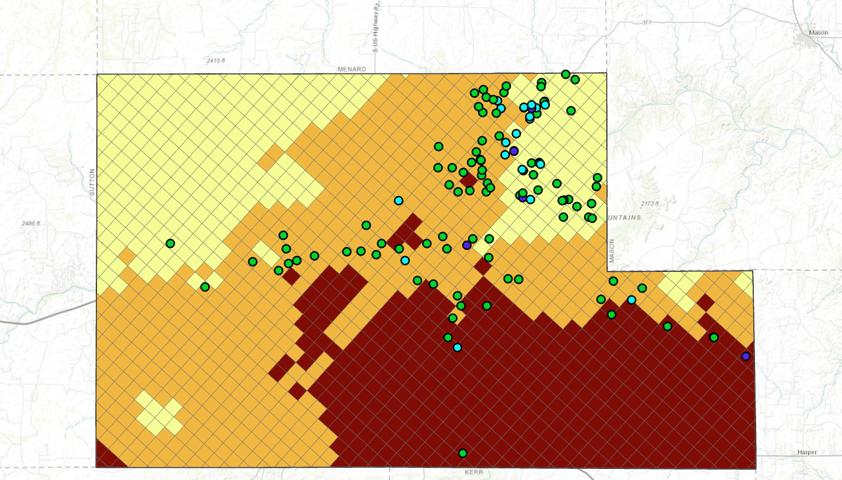
TWDB Reported Well Yields Trinity Zones
ZONE 1
ZONE 2
ZONE 3

Slide 63
Pumping Capacity of Well As Equipped (gpm) | Minimum Distance from Existing Water Well (ft)
ZONE 1
Up to 17.36 gpm
> 17.36 to 30 gpm
> 30 gpm to 50 gpm
> 50 gpm to 100 gpm
> 100 gpm to 300 gpm
> 300 gpm
ZONE 2
Up to 17.36 gpm
> 17.36 to 30 gpm
> 30 gpm to 50 gpm
> 50 gpm to 100 gpm
> 100 gpm to 300 gpm
> 300 gpm
ZONE 3
Up to 17.36 gpm
> 17.36 to 30 gpm
> 30 gpm to 50 gpm
> 50 gpm to 100 gpm
> 100 gpm to 300 gpm
> 300 gpm

Slide 64
Pumping Capacity of Well As Equipped (gpm) | Minimum Distance from Existing Water Well (ft)
ZONE 1
Up to 17.36 gpm | 150
> 17.36 to 30 gpm | 150
> 30 gpm to 50 gpm | 150
> 50 gpm to 100 gpm | 1200
> 100 gpm to 300 gpm | na
> 300 gpm | na
ZONE 2
Up to 17.36 gpm | 150
> 17.36 to 30 gpm | 150
> 30 gpm to 50 gpm | 150
> 50 gpm to 100 gpm | 500
> 100 gpm to 300 gpm | na
> 300 gpm | na
ZONE 3
Up to 17.36 gpm | 150
> 17.36 to 30 gpm | 150
> 30 gpm to 50 gpm | 150
> 50 gpm to 100 gpm | 150
> 100 gpm to 300 gpm | 150
> 300 gpm | 150

Slide 65
LIMITATIONS
Flowpaths are highly variable
GAM data are interpolated from sometimes limited data
Drawdowns are ESTIMATES and they represent pumping continuously for 50 years

